Slide 1

Lung Cancer Prediction Using Machine Learning
Advithi D-1BM21CS009 Anagha K S-1BM21CS020 Dhanush H V-1BM21CS025 Gagandeep Kattennanavar-1BM21CS064
Guide: Dr.Seema patil Designation: Assistant Professor Department of Computer Science & Engineering B.M.S. College of Engineering
Notes:
Arpana

Slide 2
OUTLINE
Introduction
Problem Statement
Literature Survey
References
Notes:
ap

Slide 3
Introduction
Lung cancer poses a serious threat to public health due to its high global death rate causing several risk factors such as age, sex , diabetes, high blood pressure ,cholesterol, abnormal pulse rate and other factors[5]. It was estimated in 2018 that around 9.6 million deaths were because of lung cancer disease, thus lung cancer is classified as one of the fatal diseases around the world[2].
Smoking is the leading cause of lung cancer, responsible for approximately 85% of all cases. The improvement of treatment results and survival rates is contingent upon early identification. Our goal is to create a prediction model for lung cancer risk assessment by utilizing machine learning techniques. Algorithm which analyses a wide range of data to determine an Individual's risk of lung cancer.
Notes:
Niha

Slide 4
Problem Statement
Develop a machine learning model to predict the likelihood of individuals developing lung cancer based on demographic, smoking history, medical, and genetic features in the Lung Cancer Prediction dataset from Kaggle. The model should help in early detection and improved patient outcomes.
Notes:
Anusree

Slide 5
Literature Survey
Sl.no | Paper details | Dataset | Algorithms/ Techniques | Result
1 | An extensive review on lung cancer detection using machine learning techniques Article in Journal of Critical Reviews · May 2020 | BRATS dataset, OASIS dataset, NBTR dataset from UCI machine learning repository | Decision trees, logistic regression, random forest, SVM, artificial neural network, naïve bayes | Ensemble outperforms all classifiers.
2 | A Study on Early Prediction of Lung Cancer Using Machine Learning Techniques ICISS 2020 | Kaggle dataset | Random forest, SVM, ANN, Naïve bayes | SVM has highest accuracy of 99.6%.
3 | Early Stage Lung Cancer Prediction Using Various Machine Learning Techniques ICECA-2020 | The Lung Image Database Consortium (LIDC-IDRI), data.world | SVM, K-nearest neighbor, random forest, ANN, Voting classifier | SVM is not suitable for large and noiseful datasets.
4 | Lung Cancer Detection System Using Image Processing and Machine Learning Techniques Advanced Trends in Computer Science and Engineering · August 2020 | LIDC-IDRI dataset | Autoencoder system, OTSU algorithm, Decision tree and CNN | A robust detection system.
5 | Lung cancer prediction using machine learning on data from a symptom equestionnaire for never smokers, formers smokers and current smokers – year 2022 | Data from prefekt@nvs.ki.se | SGB model | A risk assessment model
Notes:
Pooja

Slide 6
Literature Survey
Sl.no | Paper details | Dataset | Algorithms/ Techniques | Result
1 | Lung Cancer Incidence Prediction using Machine Learning Algorithms. Year-2020. | Data of 10 European Countries of 42 years. | SVR, Long-Short Term Memory, Backpropogation Learning Algorithm. | SVR performed the best in all experiments.
2 | Lung Cancer Prediction using Machine Learning based Feature Selection: A comparative Study. Year-2023. | Lung Cancer Dataset by staceyinrobert, Kaggle. | SVM, KNN, Multilayer Perceptron, Radial Basis Function | MLP performed best with 90% accuracy.
3 | Lung Cancer Detection using Machine Learning. Year-2022. | Kaggle Dataset. | RF, KNN, Decision Tree, LR, Naïve Bayes. | RF performed best with 88.5% accuracy.
4 | Lung Cancer Prediction Using Machine Learning Algorithms on Big Data: Survey .Year-2020. | Image data. | Support vector machine, ANN, Naïve Bayes, LR. | A predictive model for diagnosis.
5 | Prediction Lung Cancer– In Machine Learning Perspective. Year-2020. | Image data from LIDC-LDRI. | SVM, ANN, Random Forest. | ANN performed best with 92% accuracy
Notes:
Pooja

Slide 7
Literature Survey
Sl.no | Paper details | Dataset | Algorithms/ Techniques | Result
1 | Lung Cancer Prediction Using Stochastic Diffusion Search (SDS) Based Feature Selection and Machine Learning Methods year 2020. | 140 normal & 130 abnormal images were used from the cancer genome atlas (TCGA). | MRMR decision tree SDS decision, CFS naïve bayes, CFS neural network, SDS naive bayes | SDS-NN had best accuracy.
2 | Machine Learning for Early Lung Cancer Identification Using Routine Clinical and Laboratory Data year 2021. | 6,505 case patients with non–small cell lung cancer (NSCLC) & 189,597 contemporaneous control subjects | area under receiver operating characteristic curve (AUC), sensitivity, diagnostic odds ratio (OR) | AUC curve has best validation and accuracy.
3 | Lung Cancer Risk Prediction with Machine Learning Models | The present work relied on a public dataset. The number of participants is 309 | NB, BayesNet, SGD, SVM, LR, ANN, KNN, J48, LMT, RF, RT, RepTree, RotF, and AdaBoostM1 | RotF wih precision, recall equal to 97.1%
4 | Lung cancer prediction by Deep Learning to identify benign lung nodules | using NLST(National Screening List Trail) dataset | LCP-CNN technique Area under the ROC curve(AUC) | excellent performance Identification.
5 | Lung cancer Prediction and Classification based on Correlation Selection method Using ML Techniques. | "Lung Cancer Data set" | Support Vector Machine ,K-Nearest Neighbor Classifier,CNN | SVM give the best accuracy 95.56%
Notes:
Pooja

Slide 8
Literature Survey
Sl.no | Paper details | Dataset | Algorithms/ Techniques | Result
1 | Lung Cancer Detection from CT Images Using Image Processing and Machine Learning Techniques. Year- 2023 | LIDC-IDRI dataset | Logistic Regression (LR), LDA, CART, KNN, SVM, CNN. | CNN performed best with 94% accuracy
2 | Analysis Machine learning based Human Health Lung Cancer Detection. Year-2023 | A CT-Lung dataset of roughly 155,000 participants in the PLCO experiment | Cutting edge ML and DL techniques, Convolutional Neural Network (CNN) | The lung cancer database was trained using the VGG-16, a CNN model
3 | Machine Learning Techniques for Lung Cancer Risk Prediction using Text Dataset. Year-2023 | Text Datasets (Lung Cancer Dataset) | LR, DT, RF, SVM, KNN, NB | RF performed best with 90% accuracy.
4 | An Extensive Review On Lung Cancer Detection Using Machine Learning Techniques. Year-2020 | BRATS Dataset, OASIS Dataset, NBTR Dataset | Image Segmentation Technique , DT, LR, RF, SVM, ANN, NV, Ensemble Classifier, DF, LDA, Back Propagation Network ,K-Nearest | Out of all the classifiers ensemble outperformed well with 88% accuracy
5 | Predictive Modelling for Lung Cancer Detection using Machine Learning Techniques. Year-2023. | Lung cancer dataset obtained from public respiratory records. | LR, DT, RF SVM, XGB classifier, GB, and KNN. | XGB classifier archives best accuracy of 0.9907.
Notes:
Pooja

Slide 9
Comparison of the existing methods
Sl.no | Paper details | Dataset | Algorithms/ Techniques | Result
1 | Early Stage Lung Cancer Prediction Using Various Machine Learning Techniques ICECA-2020 | The Lung Image Database Consortium (LIDC-IDRI), data.world | SVM, K-nearest neighbor, random forest, ANN, Voting classifier | SVM is not suitable for large and noiseful datasets.
2 | Lung Cancer Prediction using Machine Learning based Feature Selection: A comparative Study.Year-2023. | Lung Cancer Dataset by staceyinrobert, Kaggle. | SVM, KNN, Multilayer Perceptron, Radial Basis Function | MLP performed best with 90% accuracy.
3 | Lung Cancer Risk Prediction with Machine Learning Models | The present work relied on a public dataset. (309 rows) | NB, BayesNet, SGD, SVM, LR, ANN, KNN, J48, LMT, RF, RT, RepTree, RotF, ABM1 | RotF with precision, recall equal to 97.1%
4 | Predictive Modelling for Lung Cancer Detection using Machine Learning Techniques .Year-2023. | Lung cancer dataset obtained from public respiratory records | LR, DT, RF SVM, XGB classifier, GB, and KNN. | XGB classifier archives greater accuracy of 0.9907.

Slide 10
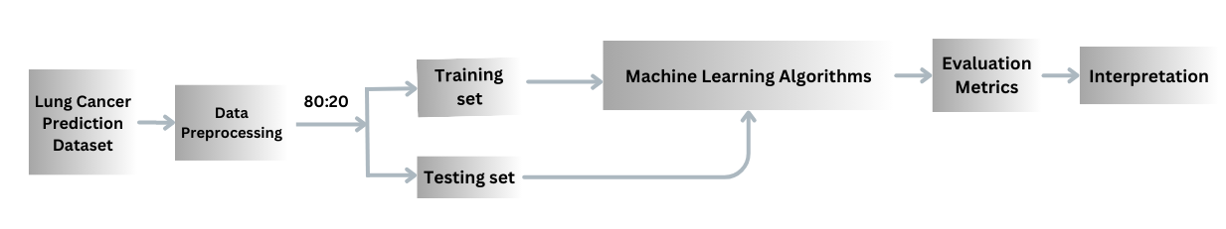
High Level Design

Slide 11
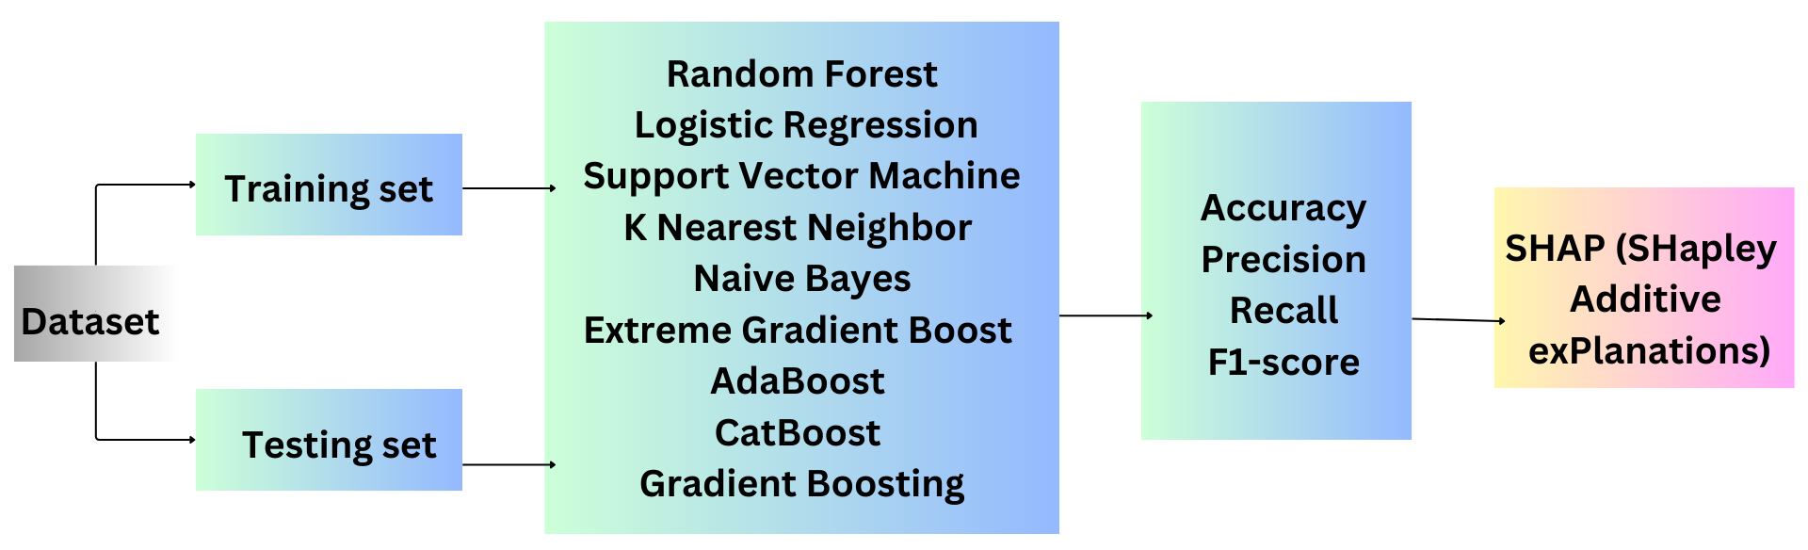
Detailed Design

Slide 12
Hardware and Software Requirements
Hardware
RAM: 16 GB or higher
CPU: Multi-core processor with at least 4 cores and 8 threads (e.g., Intel Core i7 or AMD Ryzen 7)
Storage: SSD with a capacity of 256 GB or more
Software
Jupyter Notebook
Streamlit framework
Additional Python libraries (e.g., Pandas, NumPy, Scikit-Learn, etc.)

Slide 13
Functionalities of the modules
Data Preprocessing: Cleans, imputes missing values, engineers features, and normalizes data.
Model Training: Trains ML models, evaluates performance.
Model Evaluation: Measures accuracy, precision, recall, and F1 score; generates evaluation metrics and visualizations.
Deployment (Streamlit): Creates a user-friendly interface for model deployment and real-time interaction.

Slide 14
Implementation
Dataset: The Lung cancer prediction dataset sourced from Kaggle consists of 1000 rows and 26 columns was imported out of which 1 attribute(column) namely ‘index’ was dropped.
Data Preprocessing: The dataset did not contain any missing values, duplicate rows. Label Encoder was used to convert categorical columns into numerical columns. SMOTE was implemented to overcome the imbalance in the target attribute. the dataset was checked for outliers and replaced by their thresholds, then it was divided into train(80) and test set(20) with target attribute being ‘Level’.

Slide 15
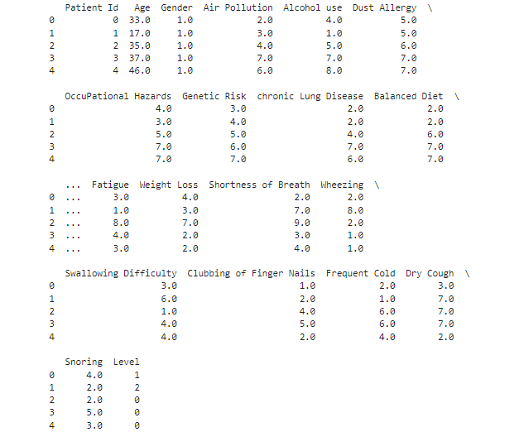
After Data Pre-processing

Slide 16
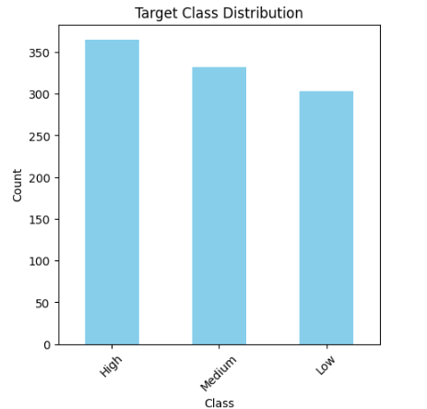
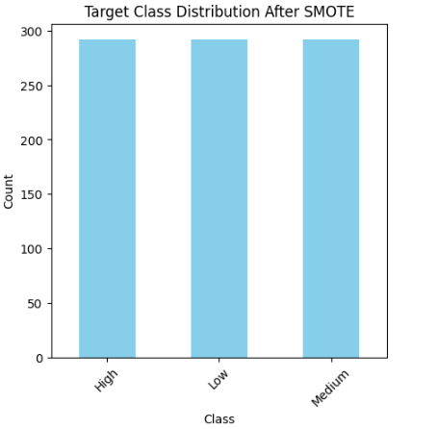
Before SMOTE
After SMOTE

Slide 17
Model Selection
K-Nearest Neighbors: KNN is a supervised machine learning algorithm. In classification, it assigns a class label to a data point based on the majority class of its k nearest neighbors in the feature space.
Support Vector Machine: SVM finds the optimal hyperplane separating classes with the maximum margin and handles non-linear data using kernel tricks.
Evaluation Metrics: Accuracy, precision, recall and F1 score were used to evaluate the performance of the models.
Shapley Additive Explanations: SHAP provides insights into how each feature contributes to the model's predictions, helping to understand the model's behavior and make informed decisions.

Slide 18


Results
K-Nearest Neighbors
Support Vector Machine

Slide 19
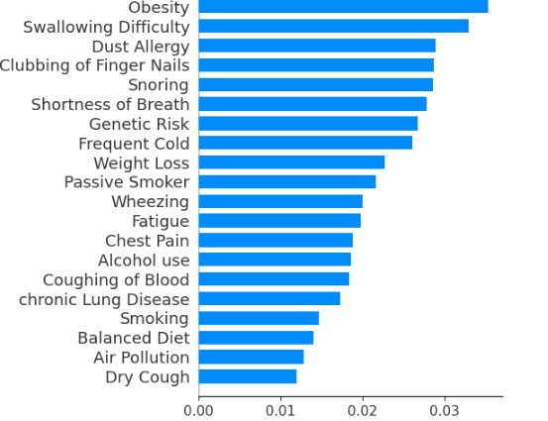
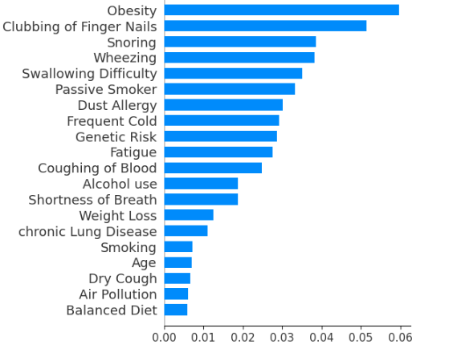
K-Nearest Neighbors
Support Vector Machine

Slide 20
Applications
Early Detection: Identify high-risk individuals for early treatment.
Clinical Decision Support: Assist healthcare decisions for better patient management.
Risk Assessment: Evaluate lung cancer risk in different populations.
Public Health Planning: Inform strategies for prevention and intervention.
Research and Trials: Stratify patient cohorts for clinical trials based on risk levels.

Slide 21
References
[1] C. Thallam, A. Peruboyina, S. S. T. Raju and N. Sampath, "Early Stage Lung Cancer Prediction Using Various Machine Learning Techniques," 2020 4th International Conference on Electronics, Communication and Aerospace Technology (ICECA), Coimbatore, India, 2020, pp. 1285-1292, doi: 10.1109/ICECA49313.2020.9297576.
[2] A. A. -C. Omar and A. B. Nassif, "Lung Cancer Prediction using Machine Learning based Feature Selection: A comparative Study," 2023 Advances in Science and Engineering Technology International Conferences (ASET), Dubai, United Arab Emirates, 2023, pp. 1-6, doi: 10.1109/ASET56582.2023.10180436.
[3] Dritsas, E.; Trigka, M. Lung Cancer Risk Prediction with Machine Learning Models. Big Data Cogn. Comput. 2022, 6, 139. https://doi.org/10.3390/bdcc6040139
[4] B. Yamini, K. Sudha, M. Nalini, G. Kavitha, R. S. Subramanian and R. Sugumar, "Predictive Modelling for Lung Cancer Detection using Machine Learning Techniques," 2023 8th International Conference on Communication and Electronics Systems (ICCES), Coimbatore, India, 2023, pp. 1220-1226, doi: 10.1109/ICCES57224.2023.10192648.
[5] B. S, P. R and A. B, "Lung Cancer Detection using Machine Learning," 2022 International Conference on Applied Artificial Intelligence and Computing (ICAAIC), Salem, India, 2022, pp. 539-543, doi: 10.1109/ICAAIC53929.2022.9793061.

Slide 22
THANK YOU
Notes:
ap

